Slide 1
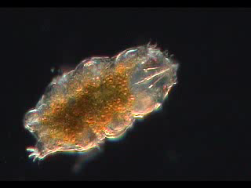
Tardigrades
AKA Water bears
“the most incredible animals on earth.”

Slide 2
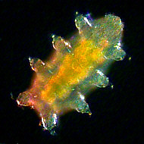
Tardigrade History
In 1702, Anton van Leeuwenhok discovered tardigrades when he poured distilled water onto dried dust and saw, under the microscope, live creatures.

Slide 3
History Cont’d.
In 1776 Lazzaro Spallanzani, saw the animals and named them tardigrada. This comes from the Greek words, slow and gait, because of their unusual movement.

Slide 4

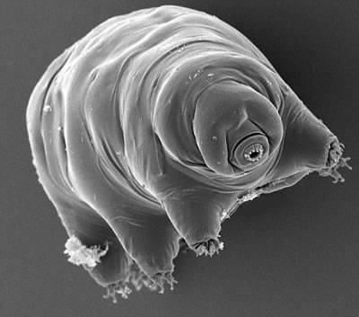
Tardi-what?
Tardigrades live in moist places such as moss, lichens, and water. (Often referred to as moss piglets) They range from half a millimeter to .001 mm long.
Tardigrades are spread across almost the entire world. They can be found on the Himalayas and in the deep ocean. They have evolved for over 300 million years to be expert survivors.
a water bear

Slide 5
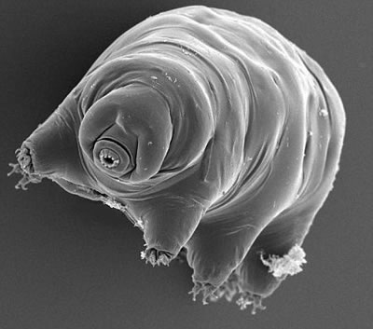
These bears have eight legs but they are not arachnids. At the end of each limb are four to eight claws. They have relatively poor control over movement of their limbs, which gives them a slow bear-like gait when they lumber over plant particles or grains of sand.
Did you know that I am probably living in your back yard?

Slide 6
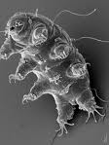
Tardigrades consume the nutrient rich fluids of various plant and animal cells. They have stylets, as seen here, which enable these delicate creatures to penetrate cell walls. Once inside the tardigrade, the pharyngeal bulb sucks out the internal contents of their food items for ingestion. Some types of water bears (there are over 400) can consume entire organisms, including other tardigrades.
Food Sources

Slide 7
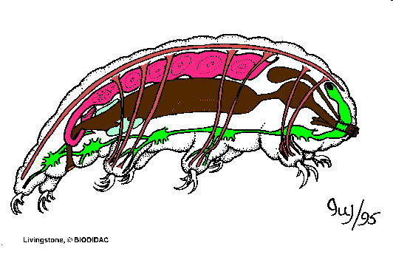
No respiratory or circulatory system

Slide 8
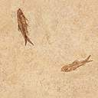
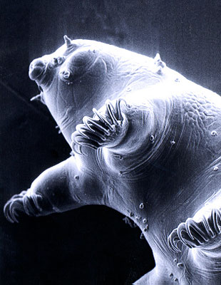

Conditions
Tardigrades are often considered one of the most resilient animals in terms of environmental conditions. Many of their habitats have dramatic changes in conditions throughout the year. This means that tardigrades must be able to adapt to extreme changes.
In various experiments, tardigrades were able to survive:
Temperatures as high as 151 degrees Celsius (303.8°F) and as low as a few degrees from absolute zero (-272.8°C).
Thousands of times of radiation than a human adult.
Up to 6000 atmospheres of pressure, according to new Japanese research. (It may be able to repair it’s own DaNA.)

Slide 9
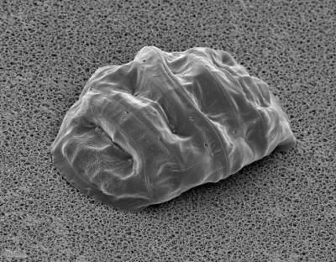
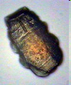
tuns
Although, they are called “water bears”, they can live for decades without water. This is due to the fact that if their surroundings run out of water, they will enter a phase called cryptobiosis, also known as the “tun” state. In this state, they will pull their legs into their bodies and shut off their metabolism. This is unique to this animal because any other animal with zero metabolism is classified as dead. Only water bears can return to life from this state. They do this by using trehalose, a type of sugar, to replace, and later, replenish water into their bodies.
Moss

Slide 10

Cryptobiosis
-When an organism ceases all metabolic function.
Anhydrobiosis
Lack of water
Many organisms can become anhydrobiotic: tardigrades , nematodes, ‘sea monkeys’, bacteria, yeast, fungi, insects, some plant seeds, etc.
With little or no water, cells will hold on to what water they have.
This causes solutes to be very concentrated and cause osmobiosis.
Anoxybiosis
Lack of oxygen
Happens in nature when an organism falls into low-oxygen water.
Chemobiosis
High levels of environmental toxins
Very similar to osmobiosis
Cryobiosis
Very low temperatures
Osmobiosis
High concentration of a given solute (usually salt)

Slide 11

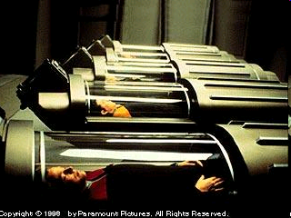
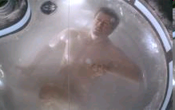
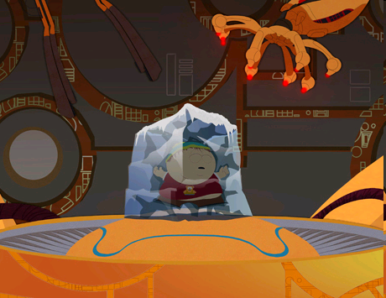
Cryonics
Many Sci-Fi books and movies have had human cryobiosis (cryonics), often for ‘suspended animation’ space travel or to wake up in the future. While scientists are still working on this, we are very far from freezing whole bodies alive successfully.
Scientists have frozen rat hearts for 10 days, using trehalose, and revived them. Currently, doctors can keep a human heart beating for four hours before it needs a transplant.
Many scientists believe that cryonics is possible for whole human bodies, but not brain tissue. Blood and sperm cells can last very long periods of time frozen but the sensitive neurons deteriorate easily and cannot survive.

Slide 12

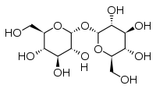
Trehalose
It has an outstanding ability to store water to keep things from drying out.
It is used in human cosmetics and pharmaceuticals to preserve human tissue.
Tardigrades store trehalose in their cells to resist dehydration while in the tun state. When exposed to water the trehalose restores moisture in the tardigrade’s cells.
C₁₂H₂₂O₁₁•2H₂O
It is a sugar
Many plants and animals use it to store energy as a carbohydrate.

Slide 13

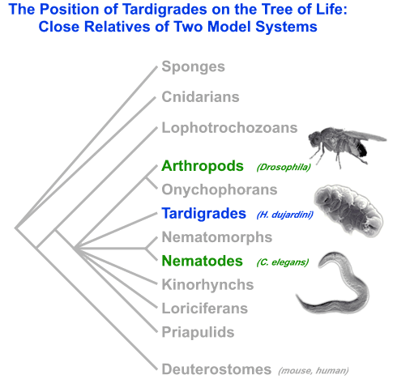

Slide 14
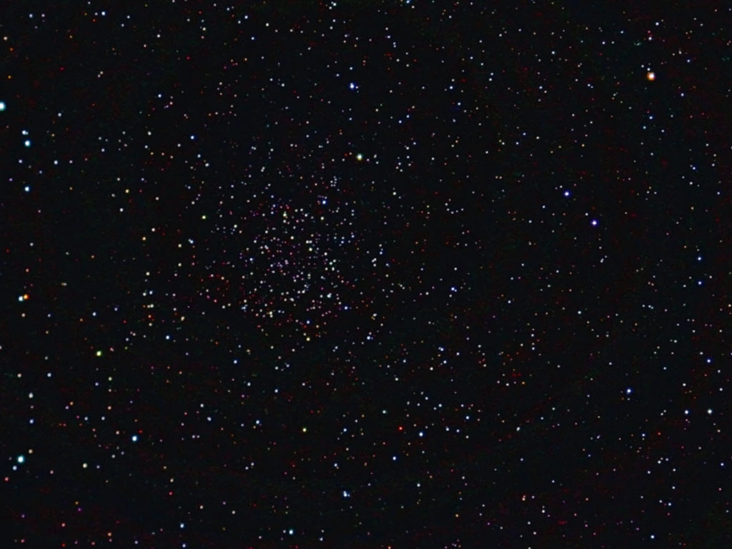
TARDIS
(Tardigrades In Space)
Space, the final frontier. Will tardigrades survive there?
In 2007 the European Space Agency sent some tardigrades into space, for 10 days, to test their survivability. Some of these were just tested in space while others were also exposed to solar radiation as well as space.
S- Tardigrades in space
O-2007-2008
A- Scientific community of the world (and others)
P- To see if tardigrades can survive the vacuum of space and solar radiation.
S- Skyler “Tardigrade” Wities
Tone- scientifically chipper.
POV: biased. We wanted them to survive

Slide 15
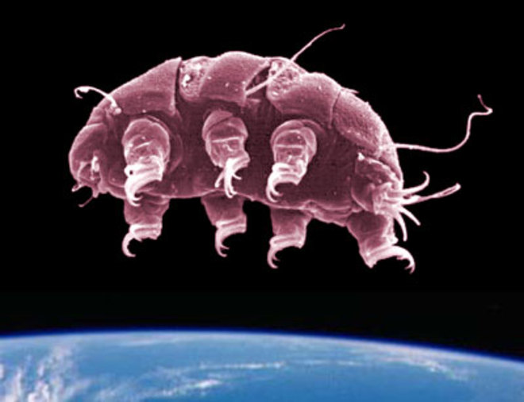
Many of the water bears exposed to the extreme dehydration of space survived and actually laid healthy eggs while in space.
The water bears exposed to space and various solar radiation, were not as lucky. About 12% survived and recovered from the full range of UV radiation and even managed to lay a small number of healthy eggs. Most of the others could recover from their tun state

Slide 16


Human Benefits
Scientists are currently researching on how tardigrades effect humans. As far as they know, tardigrades do not directly help or hurt humans. However, they are being heavily researched in Europe, in hopes that they will help with organ preservation, human reanimation, human dehydration, and space colonization.

Slide 17

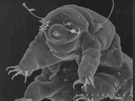
Our opinion is....
That tardigrades are a unique type of animal that is definitely worth studying more in the future. They have many interesting features that can potentially benefit the human race greatly.

Slide 18
"Strange is this animal ... because it resembles a bear in miniature."
- J.A.E. Goeze, 1773
They look more like candy gummy bears than grizzly bears.
-Leslie Mullen, 1992
[Wired Science put Tardigrades as the number 1 thing launched into space in 2008.]
“We thought they deserved to make this year’s list cause they’re so damn cute.”
-Clara Moskowitz, 2009
“Please note that it might be unwise to mention tardigrades in presence of those biology teachers who have never heard of them. We do not want to be held responsible for nervous breakdowns or any other possible consequences that might be caused by tardigrade abuse.”
-Matin Mach, 2010
(Editor of the monthly online magazine : ‘The Water Bear Web Base’)

Slide 19
Buck, Rhiannon. "Tardigrades: The World's Toughest Critters." FirstScience.com. First Science, 23 Feb. 2009. Web. 24 May 2010. <http://www.firstscience.com/home/articles/nature/tardigrades-the-world-s-toughest- critters-page-2-1_58955.html>.
Crowe, J. H., F. A. Hoekstra, and L. M. Crowe. "Anhydrobiosis." PubMed.gov. Department of Zoology, University of California, Davis, 2008. Web. 26 May 2010. <http://www.ncbi.nlm.nih.gov/pubmed/1562184>.
Darling, David. "Cryptobiosis." The Worlds of David Darling. The Internet Encyclopedia of Science. Web. 26 May 2010. <http://www.daviddarling.info/encyclopedia/C/cryptobiosis.html>.
Jönsson, K. I. "Tardigrades in Space (TARDIS)." Tardigrades In Space (TARDIS). Blogspot, 9 Jan. 2009. Web. 26 May 2010. <http://tardigradesinspace.blogspot.com/>.
Mullen, Leslie. "Extreme Animals." Ajax Poller. Astro Biology Magazine, 09 Jan. 2002. Web. 26 May 2010. <http://www.astrobio.net/exclusive/261/extreme-animals>.
"Stranger Than Fiction." National Wildlife June-July 1999. Student Resource Center - Silver. Web. 26 May 2010.
"Tardigrade Facts." Illinois Wesleyan University -- Bloomington, IL. Illinois Wesleyan University, 1999. Web. 26 May 2010. <http://www.iwu.edu/~tardisdp/tardigrade_facts.html>.
"Tardigrades." SERC. Microbial Life Educational Resources. Web. 26 May 2010. <http://serc.carleton.edu/microbelife/topics/tardigrade/index.html>.
"Tardigrades." Tardigrades - Movies and Pictures. Goldstein Lab UNC Chapel Hill. Web. 26 May 2010. <http://tardigrades.bio.unc.edu/>.
Bibliography

